Slide 1
Java Technical Training
Prepared by: Sherwin John Calleja-Tragura

Slide 2
Basic Java SDK Module
Introduction to Java Development

Slide 3
Java: An OOP Language
Introduction

Slide 4
Object-Oriented Programming Languages
SmallTalk
C++
Java
Csharp

Slide 5
Java vs C++
Java is similar to C++ so that developers can adapt the syntax
C++ has complicated syntax than Java
In C++, each platform has a different compiler while in Java only uses one
C++ can be used for embedded systems and robotics
NOTE: Java is slower than C++ but this has not been an issue due to frameworks and plug-ins

Slide 6
Java vs C#
C# uses similar syntax as C++ and handles same memory operations
C# applications can run on any system that has a C# interpreter
Only Windows can provide the interpreter
C# is only optimized for Windows OS thus C# is good only for Windows-based applications

Slide 7
Platform-Independence
Java can support the following operating systems:
Microsoft
Linux
Unix
Mac OS
Objective: Right once, Run Anywhere

Slide 8
Java SDK Language
James Gosling, Mike Sheridan, and Patrick Naughton created Java on June 1991
Initially named Oak then renamed Java from Java coffee
Intended for television and cable projects

Slide 9
Java versions
J2SE 5.0 (September 30, 2004)
Java SE 6 (December 11, 2006)
Java SE 7 (July 28, 2011)
Java SE 8 (March 18, 2014)

Slide 10

Downloading Java
Java can be downloaded at this site:
http://www.oracle.com/technetwork/java/index.html

Slide 11
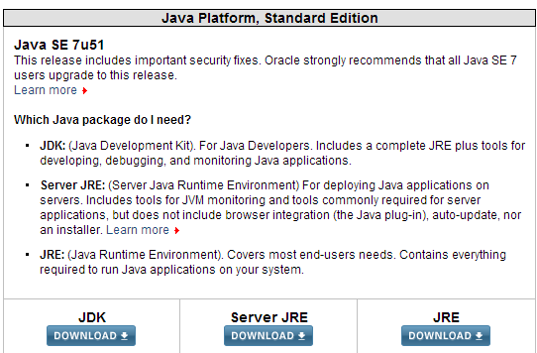
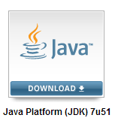
Downloading Java…
Visit Top Downloads then Java SE
After clicking Java SE, you will see the current download page:

Slide 12
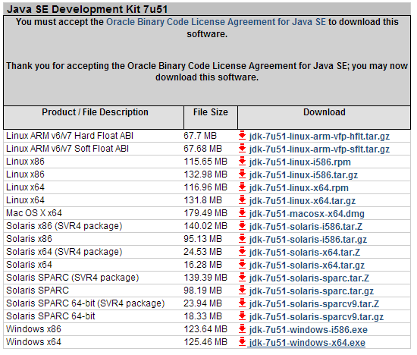
Downloading Java…
You can download Java SDK compiler depending on the OS and RAM speed used:

Slide 13
Installing Java
After downloading the .EXE file, run it.
If prompted for the JDK directory, you can use the default directory or you can opt for your own location.
The default directory is
C:\Program Files\Java\jdk1.7.x\ for Java SE 7.
NOTE: The installer will install the JDK and JRE thus it will ask for 2 directories

Slide 14
Seatwork
Install Java on your respective hosts or system.
Follow the previous instruction on how to install Sun JDK installer
Note: Do not download since the installer will be given to you.

Slide 15
Java Install Directories
bin
the Java development tools and commands
jre
the root directory for the Java Runtime Environment (JRE)
lib
additional libraries of code that are required by the development tools
include
additional plug-ins for Java-based tools

Slide 16
JRE, the virtual memory engine
The Java interpreter that allows you to run Java compiled programs
You can also download a standalone version of the JRE for computers that don’t have the JDK installed in them
There are 2 JRE folders:
the one found in the Program Files is for software applications
the one found inside the installation folder is for development

Slide 17
Setting the Classpath (Windows)
Needed if development are done using command line
Setting the bin folder in the classpath makes all the .EXE available system-wide
To configure Windows, register bin directory of Java in the PATH environment variable:
Open the System Section of the Control Panel
Select Advanced System Settings link. Windows 7 will prompt you with a User Account Control dialog box if you are not an Administrator
Create a system variable JAVA_HOME and assign the location of the JDK directory to it

Slide 18
Setting the Classpath…
Look for the Path system variable and append the following line: ;%JAVA_HOME%\bin;
Test the setup by opening any terminal console. Type the command javac

Slide 19
Seatwork
Configure manually your Java JDK installation to work as a Windows service.
Follow the previous instructions to finish the setup correctly.

Slide 20
Command Line Operations
Operating System commands
cd – means change directory
cd.. – to exit from a current directory
mkdir – to create a new directory
rmdir – to remove a directory
rm or del – variations or rmdir
Java SDK commands
javac – command to compile Java source(s)
java – to run Java bytecodes

Slide 21
Integrated Development Environment (IDE)
IBM Eclipse
Oracle Netbeans
IntelliJ IDEa

Slide 22
Using Eclipse (Summary)
Open or create a workspace
Inside the desired workspace, create projects
Each project, always create packages
NOTE: Do not create classes directly inside src
After creating packages, you can now start creating classes.
NOTE: Refer to handout for all the features.

Slide 23
Seatwork
Be sure to create the training folder structure as instructed.
Create a directory C:\Training\Demo\src
Create a package named org.acs.training.codes
Create the following code in a notepad. Do not forget to attach packages.
public class HelloWorld{
public static void main(String args[]){
System.out.println(“Hello World”);
}
}
Save the file in your src directory.
Then, compile using the correct Java commands.

Slide 24
Package
physical organization of java sources
virtual structure for java codes

Slide 25
Command Line Compilation
All compiled codes are stored inside the classes folder. Thus create C:\Training\Demo\classes.
Use the following commands to compile Java sources codes saved in a package (i.e. we will define package later):
javac –d classes src/org/itm/training/testing/P.java
javac –d classes src/org/itm/training/testing/*.java
javac –d classes –classpath classes src/org/training/testing/P.java

Slide 26
Running Compiled Codes
To run the compiled packaged sources inside classes:
java –classpath classes org.itm.training.testing.P

Slide 27
Clincher
Inside your src folder create the following directory paths:
org/orion/training/codes
org/orion/training/docs
Create the class inside the folder orion/training/codes:
package org.orion.training.codes;
public class Easy{
public static void main(String args[]){
System.out.println(“Easy”);
}
}
Save it in Easy.java file.

Slide 28
Clincher…
Create the following class inside the folder orion/training/docs:
package org.orion.training.docs;
public class Average{
public static void main(String args[]){
System.out.println(“Average”);
}
}
Save it in Average.java file.
Compile each Java source codes and store all classes in “classes” directory
Run each of the class.

Slide 29
Compilation with switches
To use a switches:
javac P.java –switch1 [ –switch2 ]
There are two javac switches:
deprecation – you can use this switch to get any additional information about any any deprecated features that your source code uses
source – you can switch this switch followed by the version number (1.3 or 1.4) to compile the codes that works with older version of Java

Slide 30
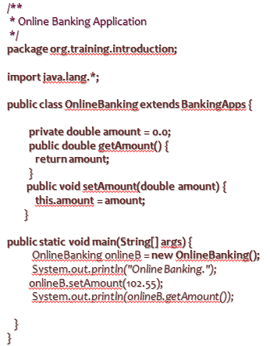
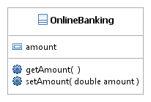
The Class

Slide 31
Basic Coding Standard
Java Coding Standards is a set of rules on how to write Java codes at the enterprise level
Some of the basic rules:
Java source is composed of statement. Each statement directs operation for the application
When you code a statement, you can start anywhere in a coding line, you can continue it from one line to another and you can code one or more spaces anywhere a single space is valid
To end most of the statements, you use a semicolon (;)
When a statement needs braces { }, it always end up with a closing brace (}). The statements within a brace is a block of code

Slide 32
Basic Coding Standard…
For easier code reading, use indentations and spacing to align statements and blocks of codes
Always document your source codes (comments)
Refer to Java Code Convention handout!

Slide 33
Class Members

Slide 34
Class: A capsule
Class is a capsule containing two members:
data
transactions

Slide 35
Legal Identifiers
Must start with a letter, a currency character ($), or a connecting character such as underscore(_)
Cannot start with a number
After the first character, identifiers can contain any combinations of letters, currency characters, connecting characters or numbers
No limit to the number of characters
Don’t use Java keyword
Case-sensitive
Use meaningful and clear indentifiers

Slide 36
Variables
Declared using the following format:
<access modifer> [non-access modifier] <type> var [= <literal>];
Used to store a value that can change as the program executes
Before you can use a variable, you must declare its data type and name, and assign a value to initialize it
Camel notation – variable naming convention where the first letter is capitalized

Slide 37
Naming Recommendations for Variables
Start variable name with a lower case letter and capitalize the first letter for all words after the first word
Choose meaningful names and easy to remember
Each variable should be a noun or a noun preceded by one or more adjectives

Slide 38
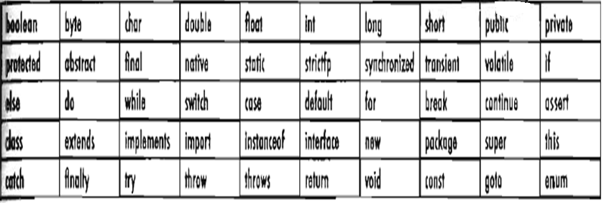
Keywords
Do not memorize all the reserved words below ☺

Slide 39
Data Types
There are two types of variables in Java:
Primitive
References
Java cares about types; variables must have types
Variables must have names
Java is a strongly typed language

Slide 40
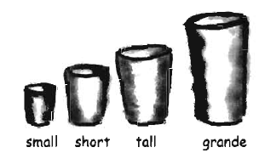
Primitive Types
Type | Bit Depth | Range
Char | 16 bits | 0 to 2¹⁶-1
boolean | JVM-Specific | true or false
byte | 8 bits | -2⁸ to 2⁸-1
short | 16 bits | -2¹⁶ to 2¹⁶-1
int | 32 bits | -2³² to 2³²-1
long | 64 bits | -2⁶⁴ to 2⁶⁴-1
Type | Bit Depth | Range
float | 32 bits | varies
double | 64 bits | varies

Slide 41
Primitive Types…
Integer types
Numbers without fractional part
Negative values are allowed
Floating-point Types
Numbers with fractional parts
All floating-point computations follow the IEEE 754 specification. In particular, there are three special floating-point values to denote overflows and errors:
Positive Infinity, Negative Infinity, NaN

Slide 42
Primitive Types…
Character Types
Individual characters
Character constants or Escape Sequences (represented by Unicode Units)
Unicode units are in hexadecimal format
Can represent ASCII numbers

Slide 43
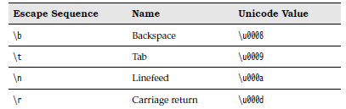
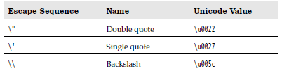
Escape Sequences

Slide 44
Literals
Floating-point literals
Can encounter loss of precision error when float data type is used
float d = 23.5678930; // ERROR
foat d = 23.5678930F; // Debugged
Double has enough container for large fp values

Slide 45
Boolean Literals
Can only be defined by true or false
Cannot use 0 or 1 values unlike in C or C++
boolean t = true;
boolean f = 0; // ERROR

Slide 46
String Literals
Not primitives but they can be represented as literals
String name = “Joey Mead”;

Slide 47
Constants
Constant are denoted by the keyword final
The value is set once and for all
Constants are named UPPERCASE
final double CM_IN_LENGTH = 5.05;
private final char LETTER= ‘a’;
double CM_IN_LENGTH = 5.05;

Slide 48
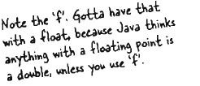
Declare, Assign and Initialize
int x;
x = 234;
byte b = 89;
boolean isFun = true;
double d = 3456.89;
char c = ‘f’;
int z = x;
boolean isPunk;
isPunk = false;
boolean powerOn;
powerOn = isPunk;
long big = 3456789;
double d = 3245.56;
float e = 3245.56f;

Slide 49
Java Methods
Methods in has a similar syntax compared to C but it differs due to the presence of modifiers in Java
Comparing it with C++, it is really equivalent except for some differences in modifiers
Syntax:
<modifier> void methodName(<type x, type c, …, type n>){
……
[ return; ]
}

Slide 50
Functions
If the method has a type, it must have a return statement:
Syntax:
<modifier> type methodName(<type x, type c, …, type n>){
return (type)
}
void is a special type which does not force function to return any value.

Slide 51
Modular Programming
To call a method:
with void type:
methodName(<parameter values>);
var. methodName(<parameter values>);
with return types:
type rval = methodName(<parameter values>);
type rval = var.methodName(<parameter values>);
Note!
Method can be called inside a method

Slide 52
Main: A Special Method
A special kind of a thread
Every class contains one or more methods (similar to functions in functional programming)
The main method is a special kind of a method that’s automatically executed when the class that holds it runs
public static void main(String args[]){}
All identifiers and methods called inside main() must be static in nature. To bypass errors:
Sample:
Easy e = new Easy();
e.x = 100;
e.getAverage();

Slide 53

Variable and Method Accessibility
A dot operator (.) gives you an access to an object’s state and behavior (instance variables and methods)
Can be accessed using dots (.)

Slide 54
Basic UML

Slide 55
Basic UML
UML stands for Unified Modeling Language
The UML is a language for
Visualizing
Specifying
Constructing
Documenting
A standard language for software blueprints

Slide 56
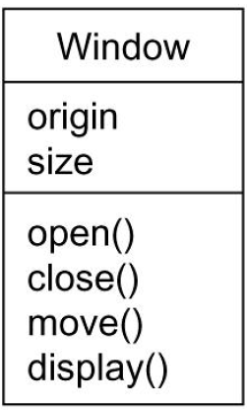
Class Diagram
One of the types of UML design strategy
Graphically, a class is rendered as a rectangle, usually including its name, attributes, and operations.

Slide 57
Interface
An interface defines a set of operation specifications (that is, their signatures) but never a set of operation implementations.
The declaration of an interface looks like a class with the keyword «interface» above the name; attributes are not relevant, except sometimes to show constants

Slide 58
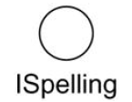
Interface (cont…)

Slide 59
Relationships
There are four kinds of relationships in the UML:
Dependency
Association
Generalization
Realization

Slide 60
Dependency
A dependency is a semantic relationship between two model elements in which a change to one element (the independent one) may affect the semantics of the other element (the dependent one).
Graphically, a dependency is rendered as a dashed line, possibly directed, and occasionally including a label.

Slide 61

Dependency (cont…)

Slide 62
Association
An association is a structural relationship among classes that describes a set of links, a link being a connection among objects that are instances of the classes.
An aggregation is a special kind of association, representing a structural relationship between a whole and its parts.

Slide 63
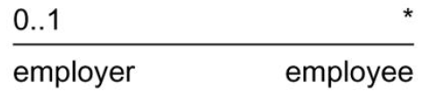
Association (cont…)

Slide 64
Generalization
A generalization is a specialization/generalization relationship in which the specialized element (the child) builds on the specification of the generalized element (the parent).
The child shares the structure and the behavior of the parent.

Slide 65

Generalization (cont…)

Slide 66
Realization
A realization is a semantic relationship between classifiers, wherein one classifier specifies a contract that another classifier guarantees to carry out.
You'll encounter realization relationships in two places: between interfaces and the classes or components that realize them, and between use cases and the collaborations that realize them.

Slide 67

Realization

Slide 68
Object-Oriented Principle
Grady Booch

Slide 69
Object-oriented Programming
Object-object programming (OOP) is a method of implementation in which programs are organized as cooperative collections of objects each of which represents an instance of some class, and whose classes are all members of a hierarchy of classes united via inheritance relationships (Grady Booch)

Slide 70
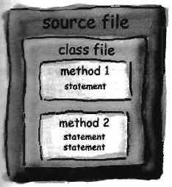
Java, as an OOP Language
A Java program is mostly a collection of objects talking to other objects by invoking each other’s methods

Slide 71
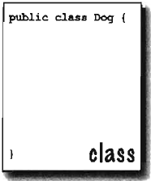
Source Code File
A Java program is written in a source file with a .java extension
A source file consists of one class definition
A class represents a piece of your program

Slide 72
Source Code Rules
There can only one public class per source code file
Comments can appear at the beginning or end of any line in the source code file
If there is a public class in a file, the name of the file must match the name of the public class
If the class is part of a package, the package statement must be the first line in the file

Slide 73
Source Code Rules…
If there are import statement, they must go between the package statement and the class declaration
Import and package statements apply to all classes within the source code file
A file can have at least one non-public class
Files with no public classes can have a name that does not match any of the classes in the file

Slide 74
Class
A class is a set of codes which consists of your data and methods
The class must go within a pair of curly braces
All methods and data must be written inside the curly braces
The content(s) of the source file
Similar to record in Pascal or struct in C/C++
The blueprint or model of your application

Slide 75
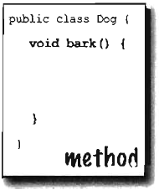
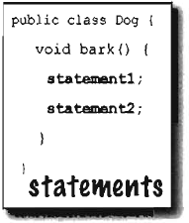
Dissecting the Class

Slide 76
Outline of a Class
Comments (headings)
Package name (at least)
Import statements (if any)
Class keyword (with access modifiers if needed)
Specify the superclass (if any)
Class body (within curly braces)
Member variables (state) and methods (behavior)

Slide 77
Rules on Naming Classes
Start the name with a capital letter
Use letters and digits only
Follow the other rules for naming an identifier
Start every word within the class name with an initial cap
Each class should be noun or a noun preceded by one or more adjectives

Slide 78
Running a Class
A class is just a template or a blueprint and cannot be executed
The running equivalent of the class is its own object(s)
The object of the class can be generated through compilation
An object can be instantiated

Slide 79
Object
A compiled class is technically called an object
An object is a representation of a real-world entity
An object only captures the needed data (or snapshot)
Characteristics of an object:
State
Behavior
Identity

Slide 80
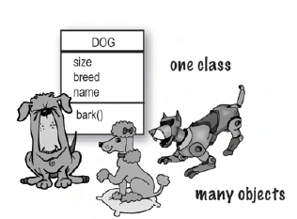
State
Defined by the attributes and the values it has
Two phases:
static state
the variables itself that identifies one object from the other
dynamic state
the literals that the attributes has changes from one situation to another
Sample class:
public class VendingMachine{
float money;
String product;
}

Slide 81
State…
Sample object:
public class OrderProd{
VendingMachine Coke;
Animal Cat;
}
Coke differs from Cat object because it has product and money attributes
public class OrderProd{
VendingMachine Coke, Sprite, IcedTea;
}
Coke.money = 4505;
Sprite.money = 3467;
IcedTea.money = 2456;
Coke differs from Sprite and IcedTea when it comes to value of money

Slide 82
Behavior
Defined by the operations an object has
Operations that are used to interact with another classes
Basic operations:
accessor
mutators
iterators

Slide 83
Behavior…
Sample:
public void Stack{
public void pop(){};
public void push(Object Input){};
public void top(){};
}
public class TestStack{
Stack stack_1, stack_2;
stack_1 = new Stack();
stack_2 = new Stack();
stack_1.push(“One”);
stack_1.push(“Two”);
stack_1.pop();
stack_2.push(“Three”);
}

Slide 84
Identity
Refers to the variable name of the object
Note: A variable corresponds to a memory address
An object is unique when it comes to its memory location
The birthmark of an object
Sample:
Stack stack_1, stack_2;
stack_1 = new Stack();
stack_2 = new Stack();

Slide 85
Review: OOP, Class and Object
A class is a blueprint or code of a process and is written inside a .java file.
Object are the compiled version of the class blueprint having the extension .class
Instantiated objects are pointed to at by reference variables
A class tells the JVM how to make an object of that particular type
Each object of that class can have its own
values of the instance variables of that class

Slide 86

Referenced Variables
Referenced variables are used to refer or access object and its state and behavior
Variables that hold bits or pointer-like values or an address
Values unknown to developers but JVM knows how to use them

Slide 87

Declaring Referenced Variables
Step-by-step processes in dealing with reference variables:
Declare a reference variable
Create an object
Link the object and the reference

Slide 88
Constructor: An Overview
a special kind of a method that is used to instantiate an object
has the same name with the class template

Slide 89

Objects in Heap
The following creates two CUP reference variables:

Slide 90
Objects in Heap…
Let the two (2) reference variables point to a common CUP object leaving the other object unreachable:
This object CUP is already for GARBAGE COLLECTION (GC)

Slide 91
Objects in Heap…
Assigning NULL to reference variables makes the variable unassigned but not yet eligibly for Garbage Collection (GC)
This object CUP is already for GARBAGE COLLECTION (GC)

Slide 92
Operators
Building Your Algorithms

Slide 93
Assignment Statement
Assignment operator (=)
Observe the following rules:
Size matters
Reference variables is not an object; it is the way to get to an object
Type matters

Slide 94
Compound Assignment
Compound Summation (+= )
Comp0und Subtraction (-=)
Compound Product (*=)
Compound Division (/=)

Slide 95
Arithmetic Operations
Addition (+)
Subtraction (-)
Product (*)
Division (/)
Remainder (%)

Slide 96
Increment/Decrement
Increment (++)
Decrement (--)
Types:
Post-increment/Post-decrement
Pre-increment/Post-decrement

Slide 97
Relational Operations
Greater Than (>)
Greater Than Equal (>=)
Less Than (<)
Less Than Equal (<=)
Equal (==)
Not Equal (!=)

Slide 98
Logical operations
Bitwise AND (&)
Bitwise OR (|)
Bitwise NOT (^)
Short-Circuit AND (&&)
Short-Circuit OR (||)
NOT (!)
XOR (^)

Slide 99
Conditional Operation
Popularly known as ternary operator
Slow running time performance
How to:
x = (boolean expression) ?
value to assign if true :
value to assign if false

Slide 100
Operator Precedence
Operators | Precedence
postfix | expr++ expr--
unary | ++expr --expr +expr -expr ~ !
multiplicative | * / %
additive | + -
shift | << >> >>>
relational | < > <= >= instanceof

Slide 101
Operator Precedence…
Operators | Precedence
equality | == !=
bitwise AND | &
bitwise exclusive OR | ^
bitwise inclusive OR | |
logical AND | &&
logical OR | ||
ternary | ? :
assignment | = += -= *= /= %= &= ^= |= <<= >>= >>>=

Slide 102
Casting Conversion
Type of conversion where the operand expression is needed to be converted to the type specified by the cast operator
Includes the following conversion processes:
identity conversion
widening primitive conversion
narrowing primitive conversion
widening reference conversion
narrowing reference conversion
boxing conversion
unboxing conversion

Slide 103
Widening Primitive Conversion
There are 19 widening conversions:
byte to short, int, long, float, or double
short to int, long, float, or double
char to int, long, float, or double
int to long, float, or double
long to float or double
float to double
Popularly known as implicit casting ☺

Slide 104
Narrowing Primitive Conversion
There are 22 narrowing conversions:
short to byte or char
char to byte or short
int to byte, short, or char
long to byte, short, char, or int
float to byte, short, char, int, or long
double to byte, short, char, int, long, or float
Popularly known as explicit casting ☺

Slide 105
Widening Reference Conversion
A widening reference conversion exists from any reference type of class S to any reference type of class T, provided S is a subtype of T
Sample:
public class Cat extends Animal{ … }
Cat a = new Cat();
Animal animal = new Animal();
Animal convertAnimal = a;

Slide 106
Narrowing Reference Conversion
From any reference type of class S to any reference type of class T, provided that S is a proper supertype of T.
Note: An important special case is that there is a narrowing reference conversion from the class type Object to any other reference type.

Slide 107
Casting Conversion
Implicit Casting (Sample)
int a = 100;
long b = a;
double c = 100L
Explicit Casting (Sample)
float a = 1000.001F;
int b = (int) a;

Slide 108
Control Structures
Decisions and Loops

Slide 109
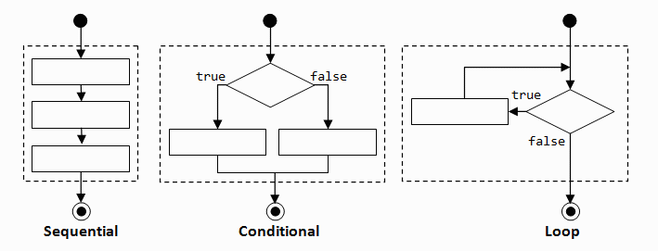
Control Structures
Basis for the interactions among objects
Triggers the conditional and loop transactions to Java objects
If-Then or If-Then-Else Statements (its Variants)
Switch Statements (its Variants)
While, Do-While and For-Loop Statements (its Variants)

Slide 110
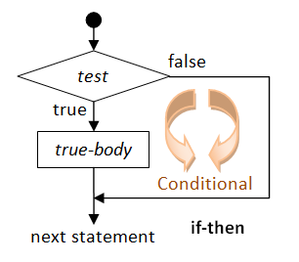
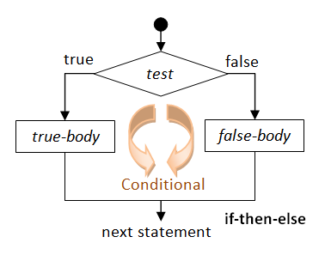
If-Then and If-Then-Else Statements
Use boolean expressions instead of integers as conditions (leads to infinite loops)
Avoid using assignment statements as conditions

Slide 111
Forms of Conditional Constructs
simple if-then statement
if (<conditions>) { … }
compound statement
if (<conditions>) { … } else { … }
nested if-statement
if (<condition>) { … }
else if (<condition>) { … }
else if (<condition>) { … }
[ else { … } ]

Slide 112
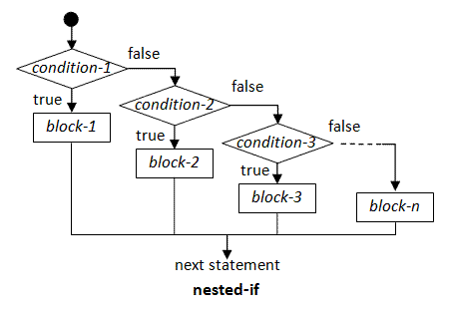
Nested If-Then-Else Statements

Slide 113
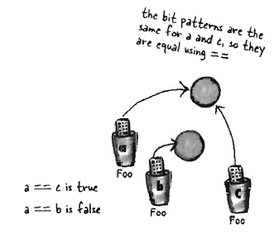
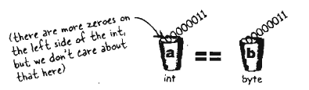
Comparing Reference and Primitive Variables
Use == to compare two primitives or to check whether reference variables refer on the same object
Use the method equal() to see if two different objects are equal

Slide 114
Type Checking
To check if a certain reference object is of type class S, we do not use ‘==‘ sign but instanceof
Used only for reference variables
Sample:
public static void main(String[] args) {
String s = new String("foo");
if (s instanceof String) {
System.out.print("s is a String");
}
}

Slide 115
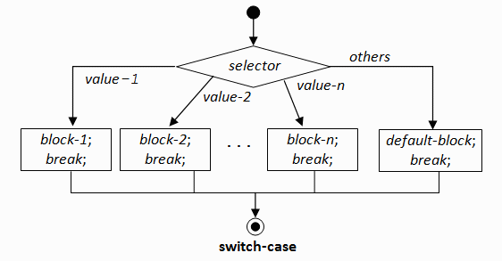
Switch Statements
Syntax
switch (expression) {
case constant1: code block
case constant2: code block
default: code block
}
Conditions are “atomic”

Slide 116
Branching
Switch statement depicts automatic equality
Data types supported by branching:
char/ boolean / integer
enum classes
String (Java 1.7)

Slide 117
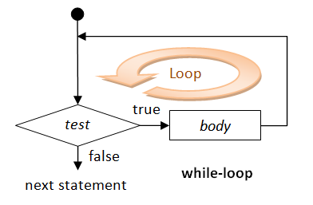
Loops and Iterations
Do-While
At least one iteration is being executed
Conditions come after the processes
While-Do
Usual iteration construct
At least zero iteration is being executed

Slide 118
Loops and Iterations…
For-loop
contains three parts:
initialization
conditional
incremental
for(int i = 0; i < upper_bound; i++){ … }

Slide 119
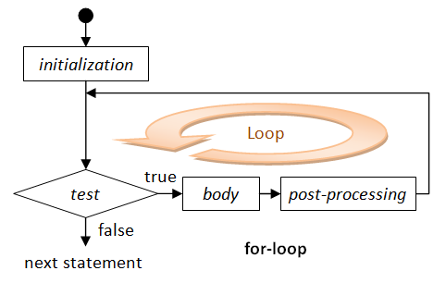
Loops and Iterations…
For-Each
Used when the number of iterations is known beforehand
In Java 5.0, we have a specialized loop for array which has the following syntax:
for ( type var : object array) {}

Slide 120
Ways to Terminate Loops
break
Stop the loop and execute the first statement immediately after the loop
return (in methods)
Stop the loop and returns the method caller
System.exit()
Stops the loop and shutdowns the JVM

Slide 121
Break and Continue
break
Eventually stops the limit
continue
Stops the current iteration and continue with the loop (with the other iterations)

Slide 122
Array Data structure

Slide 123
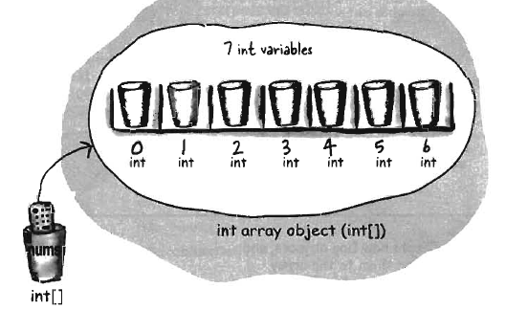
Arrays
Arrays are always objects
Used for quick, ordered and efficient lists of things
Every element in an array is just a variable (primitive or reference)
A homogenous
data structure

Slide 124
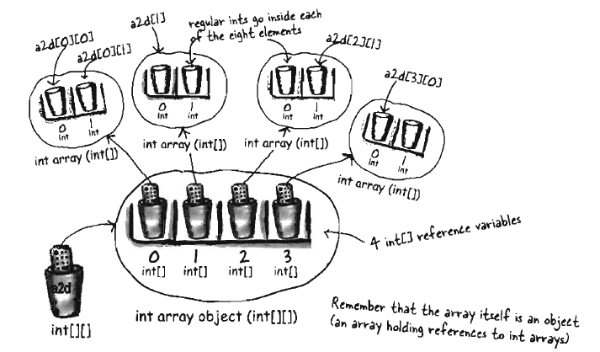
Multidimensional Arrays
Valid decalaration:
String [][][] name;
String [] name [][];
Sttring [][] name [];

Slide 125
Array Construction
Constructing a One-Dimensional Array
Using the keyword new
int [] a;
a = new int[40];
int [] a = new int[40];
Constructing a Multi-Dimensional Array
Using the keyword new
int [] [] b;
b = new int[40][];

Slide 126
Array Construction
Constructing Arrays of Reference Variables
Shape sh [];
sh= new Shape[5];
sh[0] = new Shape();
sh[1] = new Shape();

Slide 127
Initializing Arrays
Declaring, Constructing, and Initializing in One
int[] a = {1,2,3};
char [] s = {‘a’,’b’,’c’};
String[] str = {“good”, “morning”};
Shape [] v = {new Shape(),
new Shape()};

Slide 128
State and Behavior
Classification and Purposes

Slide 129
Instance Variables
Variables popularly known as global variables
Each instance of the object has its own copy
Instance variables always get a default value
Integer has a default value of zero (0)
Floating point has a default value of zero (0.0)
Boolean has a default value of false
Reference variable has a default value of null

Slide 130
Class or Static Variables
Declared with the static keyword in a class, but outside a method, constructor or a block
There would only be one copy of each class variable per class, regardless of how many objects are created from it
Note: Rarely used other than being declared as constants.
Always has the non-access modifier static

Slide 131
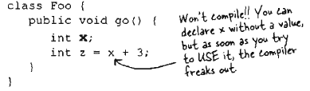
Local Variables
Local variables are variables declared inside a method
They are not instance variables
Local variables do not get a default value

Slide 132

Local Parameters
Local or method parameters are declared on the argument list of the method
Variables can be declared locally meaning within the methods of a class
If users passes arguments to a method, that method needs parameters to accommodate all the arguments passed
parameters

Slide 133
Command Line Parameters
Used by public static void main(String args[]){ }
All command line parameters are written after the class name of the Java object you are running (e.g. java HelloWorld star apple)
Command line parameters are separated by spaces and all of them are stored in the local parameter args[]

Slide 134
Blocked-scoped Variables
They are variables found inside a specific scope
The blocked-scope variables only stay in the stack during the execution of the said block
Note: Only valid within the block scope

Slide 135
Variable-argument List (var-arg)
Java 5.0 allows writing methods with variable number of arguments (var-arg)
Local parameters that can accept more than zero values
Note: Careful with null values
How to create one:
Specify the type of the argument(s)
Follow the type with an ellipsis, a space, and then the name of the array that will hold the parameters received
Must only one var-arg in a method local parameter
Together with other typical arguments, var-arg must be written the last

Slide 136
Java Bean Methods
These are Java methods that belongs to:
Accessors
Mutators
Convention:
First letter should be lowercase and normal “camel case” rules should be used
Names should be verb-noun pair
getBrand()
setBrand()
getNumOfPickups()
setRockStarUsesIt()
getRockStarUsesIt()

Slide 137
Accessors
Also known as getters
Getters are methods that aim to return whatever values needed by the caller
Rules:
if property is not a boolean, the getter method’s prefix must be get
If the property is boolean, the getter method’s prefix must be get or is
getters by convention do not have local parameters
must have a corresponding setter method

Slide 138
Mutators
Also known as setters
Setters are methods lives and breathes of taking values as arguments in order to set value of an instance variable
Rules:
the setter method’s prefix must be set
setter method signatures must be marked public with a void return type
must have a corresponding getter method
must have only one local parameter
must not return any values

Slide 139
Parameter Passing
Java uses pass-by-value method meaning pass-by-copy
Even if you pass a reference variable or a primitive value, still pass-by-value method is being followed by Java

Slide 140
Returning Values
Methods can return one value and type only
Methods may not return a value if is it void type

Slide 141
Class Declaration
Types of Classes

Slide 142
Class Modifiers
Types of class declaration modifiers:
Access modifiers – attributes attached to a class that identifies how the class must be called within another class either belonging to another package or same package
Non-access modifiers – attributes attached to a class that identifies further functionality or capability of the class

Slide 143
Class Access Modifiers
public
default
private
Note: private can be used in inner classes ONLY!

Slide 144
Public Classes
A class declaration with the public keyword gives all classes from all packages access to the public class
NOTE: Do not forget the import statement if a class belonging to another package wants to access a public class.

Slide 145
Default Classes
A class with default access has no modifier preceding it in the declaration
A class with default access can only be seen only by classes within the same package
Also knows as “package level access”

Slide 146
“Private” Classes
This is only valid if we have a special type of class called inner classes (i.e. we will discuss inner class later)
Used during design pattern implementation

Slide 147
Class Non-Access Modifiers
final
abstract
strictfp

Slide 148
Final Classes
When used in a class declaration, the final keyword means that the class can’t be sub-classed
Needed only if there is a guarantee that none of the methods of that class will be overridden
Usually used for API Core Library development

Slide 149
Abstract Classes
Can never be instantiated
Sole purpose is to for it to be sub-classed (extended)

Slide 150
Strictfp Classes
The effect of the strictfp modifier is to make all float or double expressions within the class declaration be explicitly Floating Point-strict
This implies that all methods declared in the class, and all nested types declared in the class, are implicitly strictfp

Slide 151
Rules on Abstract Classes
An abstract class can have both “template methods” and implemented methods
An abstract class can extend another abstract class
An abstract class can implement one or more interfaces
An abstract class can have both constant(s) and variable(s)

Slide 152
Interface
An interface is a contract that’s tells a class what to do
In any inheritance tree a valid interface can be implemented by any class
An interface is a template without any implementation
Is a special kind of an abstract class

Slide 153
Rules on Declaring Interfaces
All interface methods are implicitly public and abstract
All variables must be public, static and final (constants)
Interface methods must not be static
Because interface methods are abstract, they cannot be marked final
Interface can extend at least one interfaces

Slide 154
Rules on Interfaces…
Interface cannot extend anything but an interface
An interface cannot implement another interface or class
Interface must be declared with the keyword interface
Interface types can used polymorphically

Slide 155
Class Member Modifiers
Data and Module Accessibility

Slide 156
Variables and Method Access Modifiers
Class members can use four of the class modifiers:
public
protected
default
private

Slide 157
Public members
A method or variable member is declared public, it means all other accessible classes regardless of the package they belong to, can access the member
Three ways to access a public method:
Invoking a method declared in the same class
Invoking a method using a reference of the class
Invoking an inherited method
Note: The class must be accessible ☺

Slide 158
Default members
Default member may be accessed only if the class accessing the member belongs to the same package
The mode of access my be typical subclass access or inheritance

Slide 159
Private members
Members marked private can’t be accessed by code in any class other than the class in which the private was declared
A subclass can’t inherit private members
A private is invisible to any code outside the member’s own class

Slide 160
Protected members
Protected members can be accessed through inheritance by a subclass even if the subclass belongs in a different package
The subclass can see the protected member only through inheritances
Protected = inheritance

Slide 161
Non-Access Modifiers for Variables and Methods
final
abstract
transient
synchronized
native
strictfp
static
volatile

Slide 162
Final members
Final variables are not ought to be re-initialized once it has been initialized with an explicit value (constant)
Final methods are not ought to be overriden
References variable marked final can’t be reassigned to refer to a different object but the data within the object can be redefined

Slide 163
Abstract methods
An abstract method is a method that has not been declared but not yet implemented
Abstract methods contain no functional entities
It has no curly braces

Slide 164
Strictfp methods
Forces floating points and floating point-related trabsaction to adhere IEEE 754 standards
Performance depends on underlying platform (OS) where the JVM is running

Slide 165
Native methods
The native keyword informs the Java compiler that the implementation for this method is provided in another language
A native methods body must be a semicolon just like an abstract method

Slide 166
Native methods…
After generating the JNI-header file, native method names are concatenated from the following components:
the prefix Java_
the fully qualified class name
an underscore "_" separator
the method name

Slide 167
Transient variable
Cannot be serialized or “saved”
If part of a serialized class, the variables declared transient will contain NULL after the class has undergone serialization

Slide 168
Volatile variables
The value of this variable will never be cached thread-locally: all reads and writes will not go straight to “main memory”
Access to the variable acts as though it is enclosed in a synchronized block, synchronized on itself

Slide 169
Synchronized methods
The synchronized keyword indicates that a method can be accessed by only one thread at a time
Synchronized can be matched with the 4 access control levels (public, private, default, and protected)
Sample:
public synchronized String getLocation() { }

Slide 170
Static members
Exist independently of any instances created for the class
One copy of the static member regardless of the number of instances of that class
Things you can mark static:
Variables
Methods
A class nested within another class, but not within the method
Initialization blocks

Slide 171
Static members…
Things you cannot mark static:
Constructors
Classes (unless they are nested)
Interfaces
Method local inner classes
Inner class methods and instance variables
Local variables

Slide 172
Java API Packages
Widely used APIs

Slide 173
Java API and Utilities
JDK API is huge and consists of many packages (refer to JDK API specification)
These are the frequently-used packages:
java.lang (the core package) - contains classes that are core to the language itself, e.g., Object, System, String, Math, etc.
java.util - contains utilities such as Date, ArrayList, Vector, Hashtable
java.io - contains input and output classes for reading files and I/O streams
java.nio = New IO API Classes
java.net - contains networking support, such as Socket and URL

Slide 174
Java API (cont…)
java.awt (Abstract Windowing Toolkit) - contains classes for implementing a graphical user interface, including classes like Frame, Button, CheckBox.
java.awt.event - contains event handling classes, such as key-press, mouse-click etc.
java.swing - Advanced GUI classes, e.g., JFrame, JApplet etc.
java.sql - contains classes for database programming, such as Connection, Statement, ResultSet.
java.math – Mathematical transactions
java.text – formatting transactions

Slide 175
Popular API Classes
String and variants – java.lang
Data Wrappers – java.lang
Scanner – java.util
Date and Calendar– java.util
DateFormat and SimpleDateFormat – java.text
BigInteger and BigDecimal – java.math
NumberFormat and DecimalFormat - java.text
Internationalization (Locale) – java.util

Slide 176
Popular API Classes…
Properties – java.util
System – java.lang
StringTokenizer – java.util
Process and Runtime – java.lang
Iterator – java.util

Slide 177
Strings
String
StringBuffer
StringBuilder

Slide 178
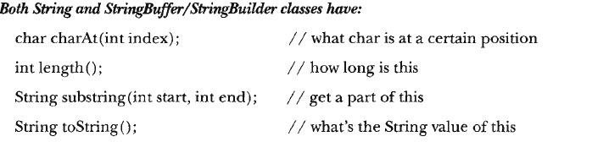
String Class
Sequence of Unicode characters which is immutable and unsynchronized
Predefined class in Java (java.lang.String)
Can be a single character string
Can be an empty string
Can be a null string

Slide 179
Immutability
An immutable object is an object whose state cannot be modified after it is created
Immutable objects are inherently thread-safe

Slide 180
StringBuffer Class
Share common methods with String class but is not immutable
Synchronized methods are present
Just like String but its values can be modified
Slightly less efficient in building strings because all methods are synchronized
String buffers are safe for use by multiple threads (thread-safe)

Slide 181
StringBuffer Class…
Popular Methods:
append(…) – methods to append boolean, strings, characters, double, float, integer, or other objects
capacity() – returns the capacity of the current StringBuffer
charAt(…), deleteCharAt(…), setCharAt(…) – manipulate characters
ensureCapacity(…) – manages the minimum capacity

Slide 182
StringBuffer Class…
Insert(…) – inserts characters anywhere in the value
Length(), setLength(…) – gets the length and sets the length of the value, respectively
getChars(…) – copies part or the whole value to a character array destination
replace(…)
reverse ()
substring(…)
toString()

Slide 183
StringBuilder Class
Introduced in Java 5.0
Not immutable object
Similar to StringBuffer when it comes to methods and functionality but no synchronization
Non-thread safe
Used on single-threaded application

Slide 184
StringBuilder Class…
All methods are just similar to StringBuffer
These methods are exclusive for StringBuilder:
appendCodePoint(…)
codePointAt(…), codePointBefore(…), codePointCount(…)
offsetByCodePoints(…)
trimToSize()

Slide 185
Guidelines for String variants
If the string is not going to change, use the String class:
As it is immutable it is safe for sharing between multiple threads
The threads will only read them, which is normally a thread safe operation.
If the string is going to change and it will be shared between threads, then use the StringBuffer class:
This class is designed for just this situation
Using this class in this situation will insure that the string is updated correctly
The chief drawback is that the methods may execute slower

Slide 186
Guidelines to String variants…
If the string is to change but will not be shared between the threads, use the StringBuilder class:
It allows modification of the strings but does not incur the overhead of synchronization
The methods of this class will execute as fast as, or faster, than those of the StringBuffer class

Slide 187
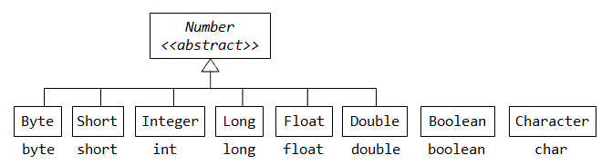
Wrapper Classes
Wrapper classes are needed instead of its primitive type equivalent when:
Data structure only stores objects and not primitives and also evaluate itself
Objects are only needed due to modification and object passing
For synchronization and multi-threading

Slide 188
Wrapper and Primitive Types
Some samples are:
Integer aIntObj = new Integer(5566)
Double aDoubleObj = new Double(55.66)
Character aCharObj = new Character('z');
Boolean aBooleanObj = new Boolean(true);
All wrapper classes contain the following constants :
MIN_VALUE
MAX_VALUE
SIZE

Slide 189
Wrapper and Strings
The wrapper classes contain public static method to parse a String into respective primitive value:
public static byte parseByte(String s) throws NumberFormatException
public static short parseShort(String s) throws NumberFormatException
public static int parseInt(String s) throws NumberFormatException
public static long parseLong(String s) throws NumberFormatException
public static float parseFloat(String s) throws NumberFormatException
public static double parseDouble(String s) throws NumberFormatException
public static boolean parseBoolean(String s)

Slide 190
Auto-boxing and Auto-unboxing
Prior to JDK 1.5, the programmers have to explicitly wrap a primitive value into an object, and explicitly unwrap an object to get a primitive value
JDK 1.5 introduces a new feature called auto-boxing and auto-unboxing, where the compiler could do the wrapping and unwrapping automatically for you based on their contexts

Slide 191
Auto-boxing and Auto-unboxing…
Samples:
Integer intObj = 5566; // autobox from int to Integer
int i = intObj; // auto-unbox from Integer to int
Double doubleObj = 55.66; // autoboxing from double to // Double
double d = doubleObj; // atuo-unbox from Double to // double

Slide 192
Characters
Character
This deals with the manipulation of character data
Charset
This defines a mapping between Unicode characters and a sequence of bytes
CharSequence
An interface implemented by the String, StringBuffer and StringBuilder classes defining common methods

Slide 193
Characters…
StringTokenizer
This is used for tokenizing text
StreamTokenizer
This is used for tokenizing text from stream like files
Capable of recognizing identifiers, numbers, quoted strings, and various comment styles.
Collator
This is used to support operations on locale specific strings

Slide 194
Properties Class
Properties are configuration values managed as key/value pairs
In each pair, the key and value are both String values
The key identifies, and is used to retrieve, the value, much as a variable name is used to retrieve the variable's value
The key must be unique

Slide 195
Properties Class…
How to input key/value pairs into the configuration file:
Sample:
prop.setProperty("database", "localhost"); prop.setProperty("dbuser", "mkyong"); prop.setProperty("dbpassword", "password");
prop.store(new FileOutputStream("config.properties"), null);

Slide 196
Properties Class…
How to retrieve key/values from the configuration file:
Sample:
prop.load(new FileInputStream("config.properties"));
System.out.println(prop.getProperty("database")); System.out.println(prop.getProperty("dbuser")); System.out.println(prop.getProperty("dbpassword"));

Slide 197
Scanner Class
Accepts I/O classes on its initialization
Scanner sc = new Scanner(new File(“io.txt”));
Scanner sc = new Scanner(System.in);
Popular methods:
next()
nextInt()
nextLong()
nextDouble()

Slide 198
StringTokenizer Class
Allows Java applications to break or split strings into several tokens
All methods in the class does not distinguish one token from the other
The set of delimiters (the characters that separate tokens) may be specified either at creation time or on a per-token basis

Slide 199
StringTokenizer Class…
Behavior:
By default, the delimiter is whitespace
Can have a returnDelim parameter:
If returnDelim is false, the delimiter serves to separate the strings into tokens
If returnDelim is true, delimiter is part of the tokens
You can set delimiter at runtime via nextToken(String delimiter)
You can have more than one delimiter

Slide 200
StreamTokenizer Class …
All comments are ignored by the stream tokenizer.
Characters such as *, ;, (, ), {, }, [, ], = and + are tokens in their own right but do not have a specific ttype (their ttype value is there ASCII value)
Strings are output as strings without the double quotes and with carriage returns (\n) if encountered. The ttype value for a string is
34, which is the ASCII value for a double quote.
End of line carriage returns are not considered to be tokens (we have no tokens of type TT_EOL).

Slide 201
StreamTokenizer Class…
A stream tokenizer takes an input stream and parses it into tokens, allowing the tokens to be read one at a time
Stream can be input streams or files
Use for parsing files
Process:
Create a new FileReader.
Create a new StreamTokenizer that parses the given fileReader.
Iterate over the tokens of the tokenizer and print their values, using sval method of StreamTokenizer that contains a string giving the characters of the word token.
Close the fileReader.

Slide 202
StreamTokenizer Class …
Four possible predefined types:
TT_EOF
TT_EOL
TT_Number
Word

Slide 203
BigInteger Class
Immutable arbitrary-precision integers
Its operators behave just like operators of the primitive types
Popular methods:
abs()
add(BigInteger b)
and(BigInteger b)
andNot(BigInteger b)
compareTo(BigInteger b)

Slide 204
BigInteger Class…
divide(BigInteger b)
divideAndRemainder(BigInteger b)
doubleValue()
pow(int x)
multiply(BigInteger b)
subtract(BigInteger b)
longValue()
floatValue
shiftLeft()

Slide 205
BigDecimal Class
Purpose of use is same with BigInteger but only applied to double or float numbers.
Note:
Do not use BigInteger and BigDecimal together in an expression

Slide 206
Date Class
Class to get the Date and Time
Samples:
Date currentDate = new Date();
Date manualdate = new Date(111,9,19);
Popular methods:
getDate() – returns day of the month
getDay() – returns day of the week
getMonth() – returns month

Slide 207
Date Class…
getYear() – returns the year
getHours() – returns hour of the time
getMinutes() – returns minutes of the time
getTime() – returns time in milliseconds
setYear(…), setMonth(…), setDate(…)
parse(String) – evaluates the string and returns the time value

Slide 208
Calendar Class
Is an abstract class that can be used to convert instant of time and some calendar constants for manipulating calendar fields
To get all the calendar values we create Calendar object via:
Calendar c = Calendar.getInstance();
The base calendar epoch is always January 1, 1970

Slide 209
DateFormat Class
Is an abstract class for date and/or time formatting subclasses which formats and parses dates or time in a language-independent manner
To create DateFormat instance:
DateFormat df = DateFormat.getInstance()
DateFormat df = DateFormat.getDateInstance(…)
DateFormat df = DateFormat.getTimeInstance(…)
DateFormat df = DateFormat.getDateTimeInstance(…)

Slide 210
DateFormat Class…
DateFormat formatting styles:
FULL
is pretty completely specified, such as Tuesday, April 12, 1952 AD or 3:30:42pm PST
LONG
longer, such as January 12, 1952 or 3:30:32pm PST
MEDIUM
longer, such as Jan 12, 1952 or #:30:32 PM
SHORT
completely numeric, such as 12/13/52 or 3:30pm

Slide 211
DateFormat Class…
To format a date, the output is ALWAYS Strings:
df.format(Date date);

Slide 212
SimpleDateFormat
SimpleDateFormat is a concrete class for formatting and parsing dates in a locale-sensitive manner
SimpleDateFormat allows you to start by choosing any user-defined patterns for date-time formatting

Slide 213
SimpleDateFormat Class…
To create instance of the SimpleDateFormat:
SimpleDateFormat sdf = new SimpleDateFormat(“ yyyy MMM dd”);
To parse the date:
sdf.format(date);
To output the new formatted date:
sdf.toString();

Slide 214
NumberFormat
An abstract base class for all number formats. This class provides the interface for formatting and parsing numbers
Sample:
NumberFormat nf1 = NumberFormat.getInstance(); System.out.println(nf1.format(1234.56));
NumberFormat nf2 = NumberFormat.getInstance(Locale.GERMAN); System.out.println(nf2.format(1234.56));
Formatting focuses only on decimal places, percentage, and currency

Slide 215
DecimalFormat
DecimalFormat is a concrete subclass of NumberFormat that formats decimal numbers
It has huge Locale support for digits
Sample:
DecimalFormat df1 = new DecimalFormat("####.000"); System.out.println(df1.format(1234.56));
Locale.setDefault(Locale.GERMAN);
DecimalFormat df2 = new DecimalFormat("####.000"); System.out.println(df2.format(1234.56));

Slide 216
System Class
This class contains all the methods that will manage the system:
Contains input/output buffer
Contains Garbage Collection capability
Get all information of the system

Slide 217
Runtime Class
Used to interface with the external environment
Can also have some System utilities
Safe and efficient when used together with Process:
Process class manages command processes invoked by Runtime class

Slide 218
Assertion and Exceptions
Handling Exceptions

Slide 219
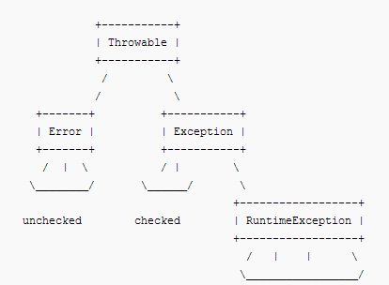
Throwable Family Tree

Slide 220
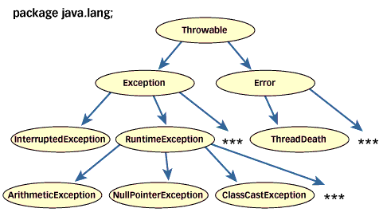
Throwable Tree…

Slide 221
Exceptions
Exceptions are the customary way in Java to indicate to a calling method that an abnormal condition has occurred
Exceptions are objects so when you throw an exception, you throw an object. You can't throw just any object as an exception, however -- only those objects whose classes descend from Throwable.
Note: Throwable serves as the base class for an entire family of classes, declared in java.lang, that your program can instantiate and throw

Slide 222
Error Handling vs Exception Handling
Errors arises when there is:
User error (for example, providing a bad file name or a poorly formatted input file). A good program should be written to anticipate these situations, and should deal with them. For example, given a bad file name, an interactive program could print an error message and prompt for a new name.
Programmer error (i.e., a buggy program). These errors should be detected as early as possible to provide good feedback. For some programs it may be desirable to do some recovery after detecting this kind of error; for example, writing out current data

Slide 223
Error Handling vs Exception Handling…
Error Handling Mechanism
Write an error message and quit. This doesn't provide any recovery.
Return a special value to indicate that an error occurred. This is the usual approach for C functions (which often return 0 or -1 to signal an error). However:
It doesn't work if the function also returns a value on normal completion and all values are possible (i.e., there is no special value that can be used to signal an error).

Slide 224
Error Handling vs Exception Handling…
It requires that calling code check for an error. This can reduce the efficiency of the code, and is often omitted by programmers out of laziness or carelessness.
It can sometimes make the code more clumsy. For example, if function g might return an error code, one would have to write something like:
ret = g(x);
if (ret == ERROR_CODE) { ... }
else f(ret);
instead of just:
f(g(x));

Slide 225
Error Handling vs Exception Handling…
Use a reference parameter or a global variable to hold an error code. This solves the first problem of the previous approach, but not the second or third ones.
Use exceptions. This seems to be the method of choice for modern programming languages.

Slide 226
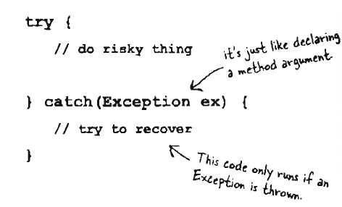
Exception Handling
When an error is detected, an exception is thrown

Slide 227
Exception Handling
What really happens is:
The code that caused the error stops executing immediately
The control is transferred to the catch clause for that exception of the first enclosing try block that has such a clause
The try block might be in the current function (the one that caused the error), or it might be in some function that called the current function (i.e., if the current function is not prepared to handle the exception, it is "passed up" the call chain).
If no currently active function is prepared to catch the exception, an error message is printed and the program stops

Slide 228
Try/Catch Block
This block tells the compiler that an exceptional things may happen in the method you are calling
Compiler does not care how you handle the exceptions
An exceptions is an object of type Exception

Slide 229
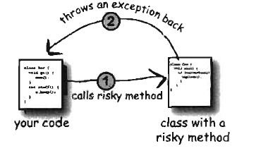
Risky Methods
The try/catch block works only with the caller of the risky method
Risky method that has probable exception must throw those possible exceptions

Slide 230
Types of Exceptions
Checked Exceptions
Exceptions that are checked at compile time
If some code within a method throws a checked exception, then the method must either handle the exception or it must specify the exception using throws keyword
Unchecked Exceptions
Exceptions that are not checked at compiled time
In C++, all exceptions are unchecked, so it is not forced by the compiler to either handle or specify the exception. It is up to the programmers to be civilized, and specify or catch the exceptions
In Java exceptions under Error and RuntimeException classes are unchecked exceptions, everything else under Throwable is checked.

Slide 231
Designing Exception Handling
Simple try-catch block
Using Exception Hierarchy (catch branching)
Using multi-catch (Java 1.7)
Throwing and Re-throwing Exceptions
Using try-with-resource (Java 1.7)

Slide 232
Finally Clause
A finally clause is usually included to make sure that some clean-up (e.g., closing opened files) is done.
A finally clause always executes when its try block executes (whether or not there is an exception).
If the finally clause includes a transfer of control statement (return, break, continue, throw) then that statement overrides any transfer of control initiated in the try or in a catch clause.

Slide 233
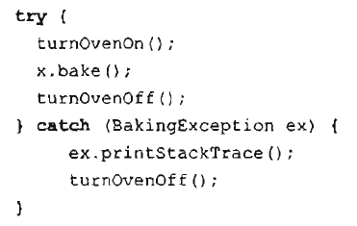
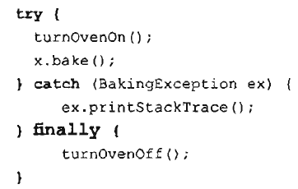
Finally Block…

Slide 234
Finally Block…
Issues on transfer of control vs finally block
No exception occurs during execution of the try, and no transfer of control is executed in the try.
The finally clause executes, then the statement following the try block.
No exception occurs during execution of the try, but it does execute a transfer of control.
The finally clause executes, then the transfer of control takes place.
An exception does occur during execution of the try, and there is no catch clause for that exception.
The finally clause executes, then the uncaught exception is "passed up" to the next enclosing try block, possibly in a calling function.
An exception does occur during execution of the try, and there is a catch clause for that exception. The catch clause does not execute a transfer of control.
The catch clause executes, then the finally clause, then the statement following the try block.
An exception does occur during execution of the try, there is a catch clause for that exception, and the catch clause does execute a transfer of control.
The catch clause executes, then the finally clause, then the transfer of control takes place.

Slide 235
Defining Custom Exceptions
Java exceptions are objects.
Define an exception by defining a class, for example:
public class EmptyStackException extends Exception { }
Note: New exceptions must be subclasses of Throwable; as discussed, they are usually subclasses of Exception (so that they are checked). The exceptions you define do not have to be public classes; however, remember that if you do not make them public, then they can only used in the package in which they are defined.

Slide 236
Throwing Exceptions
Throw an exception using a throw statement:
public class Stack {
...
public Object Pop() throws EmptyStackException {
if (Empty()) throw new EmptyStackException();
...
}
}
Note:
Exceptions are objects, so you cannot simply throw "EmptyStackException" -- you must use "new" to create an exception object.
Since the Pop method might throw the (checked) exception EmptyStackException, that must be included in Pop's throws clause.

Slide 237

Assertions
Debugging your codes just like adding System.out.println() in your codes
Ignored by JVM during normal compilation
Enabled by default in Java 5.0
For JVM to recognize assertion statements, use java command line option –ea
Syntax:
assert (boolean expression) ;
assert (boolean expression) : “custom error message”:

Slide 238
Principles of OOP
Introduction to Principles of OOP

Slide 239
Guidelines of OOP
4 Principles of OOP
Core principles of Java/JEE Development
11 Principles of OOD
Core principles of Java Architecture

Slide 240
Principles of OOP
Abstraction
Encapsulation
Inheritance
Polymorphism

Slide 241
Principles of OOD
(SRP) The SingleResponsibilityPrinciple
(OCP) The OpenClosedPrinciple
(LSP) The LiskovSubstitutionPrinciple
(ISP) The InterfaceSegregationPrinciple
(DIP) The DependencyInversionPrinciple
(REP) The ReuseReleaseEquivalencePrinciple
(CCP) The CommonClosurePrinciple
(CRP) The CommonReusePrinciple

Slide 242
Principles of OOD…
(ADP) The AcyclicDependenciesPrinciple
(SDP) The StableDependenciesPrinciple
(SAP) The StableAbstractionsPrinciple

Slide 243
Abstraction
Defines conceptual boundaries of the class with respect to its implementation:
Assess the State
Consider the Behavior
Generate the Identity
Distinguishes the characteristcs, properties and the behavior of the objects
Creates templates or abstract blueprints

Slide 244
Encapsulation
Aims to avoid duplication in the code design
Provides security to some data or properties
Hides implementation details of the class from unnecessary CHANGES
Makes the code more maintainable by grouping together related properties

Slide 245

Encapsulation…
To protect your data and implementation from unwanted modification:
Mark your instance variable private
Provide public getters and setters for access control

Slide 246
Advantages of Encapsulation
Secured and provide accessibility rules
Best protocol if creating huge enterprise projects

Slide 247
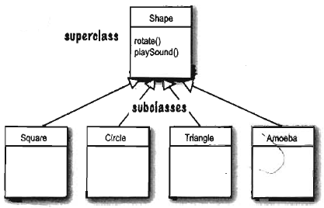
Inheritance
Process by which one object acquires the properties of another object
Re-usability of classes in other classes
Concept of superclass and subclass
Concerns more on the structural relationship among objects

Slide 248
Class Relationship
IS-A Relationship
HAS-A Relationship

Slide 249
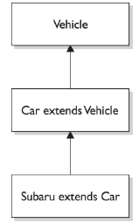
IS-A Relationship
“this thing is a type of that thing”
Creates an inheritance tree

Slide 250
HAS-A Relationship
Based on the usage rather than the inheritance
Class A HAS-A B if code in class A has a reference to an instance of class B

Slide 251
Overloading Methods
Primary way of implementing polymorphism
The following are scenarios when doing method overloading:
appear in the same class or a subclass
have the same name but,
must have different parameter lists, and,
can have different return types

Slide 252
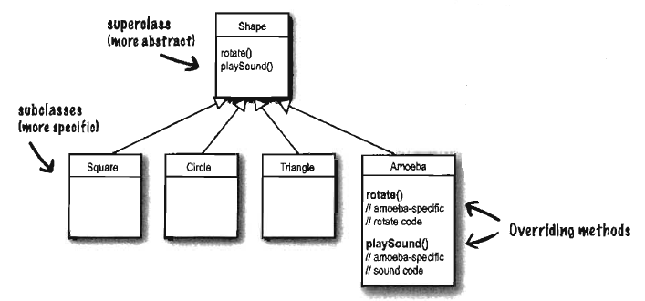
Overriding Methods
Overriding just means that a subclass redefines one of its inherited methods when it needs to change or extend the behavior of that method

Slide 253
Types of Methods
Types of methods that can be overriden:
normal transactional methods
public void sampleMethod(){ … }
abstract methods
public abstract void deadMethod();

Slide 254
Overriding Methods…
The following are scenarios when doing method overriding:
appear in subclasses
have the same name as a superclass method
have the same parameter list as a superclass method
have the same return type as a superclass method
The throws clause of the overriding method may only include exceptions that can be thrown by the superclass method, including it's subclasses

Slide 255
Overriding (cont…)
the access modifier for the overriding method may not be more restrictive than the access modifier of the superclass method
if the superclass method is public, the overriding method must be public
if the superclass method is protected, the overriding method may be protected or public
if the superclass method is default, the overriding method may be default, protected, or public
if the superclass methods is private, it is not inherited and overriding is not an issue

Slide 256
Overriding Issues
A super class cannot utilize the properties of its subclasses (no turning back)
If a subclass needs to use both superclass version and its own overriding subclass version, the keyword super is used to distinguish methods of superclass from the subclass
Super classes can be normal transactional classes or abstract classes
public abstract class SuperClass{ …. }

Slide 257
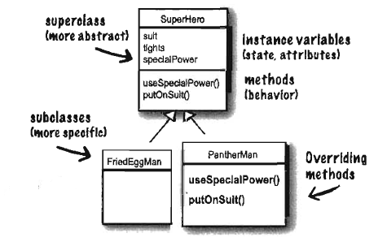
Use of inheritance
In designing inheritance, you put common codes in a class and tell other more specific classes that this common class (more abstract) is their superclass

Slide 258
Use of Inheritance…
Abstract class are most preferred superclass design for almost all of the current projects
Ordinary classes can still be used as common classes or template

Slide 259
What to Inherit?
A subclass cannot inherit all members of the superclass
It depends on the member’s access level control
public
protected
default

Slide 260
Advantages of Inheritance
You can avoid duplication
You define common protocol for a set of classes

Slide 261
Polymorphism
Create functions or reference variables which behaves differently in different programmatic context
Deals with how the program decides which methods it should use, depending on what type of thing it has
The reference type is the superclass of the object type
Main objective:
create classes of different forms with different purposes

Slide 262
Polymorphic relationship
A class that contains all the methods is the base class
Derived classes borrows the methods of the base class

Slide 263
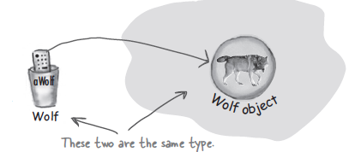
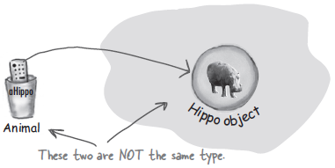
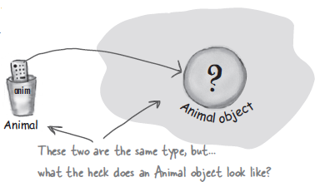
Strict Polymorphism

Slide 264
Strict Polymorphism…
Sometimes designing polymorphism will lead to a subclass that gets all needed methods from two or more super classes (multiple inheritance)
To avoid this impossible design in Java, we can use interfaces

Slide 265
Types of Polymorphism
Single Polymorphism
Multiple Polymorphism

Slide 266
Advantages of Polymorphism
Maintainability and for ease of design
To put constraint on what “type” or “group” of objects to create:
List list1 = new ArrayList(); list1 = new Vector()
List list2 = new LinkedList(); list2 = new Vector();
Set set1 = new HashSet(); set1 = new TreeSet();
To create objects having common methods or processes

Slide 267
Collections Framework
Introduction to Java Data Structures

Slide 268
Review on Arrays
Array indexes start at 0
Indexes have to be integers
An array can hold primitive data types or objects
Arrays provide constant time random access which is an efficient way of accessing data
Arrays provide good locality of reference
Arrays are more difficult to insert or remove elements than other data structures
An index to an invalid element is possible

Slide 269
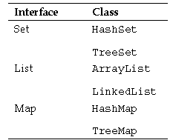
Collection Framework
Collection Framework mandates the common behaviors of all the classes
Consists of series of interfaces and
classes together responsible
for data management at runtime
Dynamically allocate data

Slide 270
List Collections
Data structure which is index-related
Implementations of List:
ArrayList
Vector
LinkedList

Slide 271
ArrayList
It is flexible
Grows as needed
Possesses many useful methods
Access is performed in constant time
Insertion/deletion is performed in linear time
Can be traversed with indexes, for-each loops, or iterators

Slide 272

Creating ArrayList
A default constructor
One that accepts a Collection object
One that accepts an initial capacity

Slide 273
Inserting An Object
add( ) and its overloads
addAll( )
Note: Replacing object is done by using set ( )

Slide 274
Retrieving Object
get( )
indexOf( )
lastIndexOf( )

Slide 275
Traversal
Typical for-loop
For-each loop
Using Iterator class
Using ListIterator class

Slide 276
Arranging ArrayList Elements
sort( )
reverse ( )
shuffle ( )

Slide 277
Removing Data
clear( )
removes all elements from the list
remove ( )
removes individual method from the list
removeAll( )
remove a certain list objects from the list

Slide 278
When to use arrays?
There is a known number of elements
It has a small fixed upper bound
Primitive data types are needed for efficiency
No elements need to be inserted

Slide 279
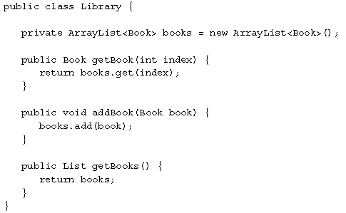
Best practice
Always encapsulate your ArrayList

Slide 280
Vector
One of the oldest Collection classes
Basically same as ArrayList but methods are synchronized for thread safety which add more overhead to its performance
Used only in mobile and batch processing (concurrent applications)

Slide 281
LinkedList
Ordered by index position like ArrayList except that the elements are doubly-linked list to one another
Contains method that deletes element at the front and end of the list
Used for transactions with too much deletion and insertion overhead
Iterate more slowly than ArrayList

Slide 282
Set Collections
Data structure which gives importance to uniqueness
Does not allow duplicates
Some implementations are:
HashSet
LinkedHashSet
TreeSet

Slide 283
HashSet
It is an unordered, unsorted Set
Uses hashcode of the object being inserted
Use this when you don’t want duplicates and you don’t care about the order of the iterations of all the elements

Slide 284
LinkedHashSet
It is an ordered version of HashSet that maintains a doubly-linked List across all elements
Use this when you care about the order of data entry

Slide 285
TreeSet
One of the sorted collections (the other one is TreeMap)
It used Red-Black tree structure and guarantees that the elements will be in ascending order

Slide 286
Map Collections
It gives importance on unique identifiers
Maps unique key to a specific value
Both keys and its values are objects
Some specific implementations:
HashMap
Hashtable
LinkedHashMap
TreeMap

Slide 287
HashMap
It gives an unsorted, unordered Map
Use this when you need a Map data structure that gives no priority to the order of the element

Slide 288
LinkedHashMap
It is a Map that maintains insertion order

Slide 289
Hashtable
Prehistoric data structure
A synchronized HashMap

Slide 290
TreeMap
It is a sorted Map
Sorted by natural order of the elements

Slide 291
Queue
A unique kind of Collections
Mainly used for multiprocessing and time-slicing
Also a data structure which is though of as FIFO
Uses methods like:
peek() and element()
poll() and remove()
offer() and add();

Slide 292
Types of Queue
As a collections here are some common and rare Queue types:
PriorityQueue – FIFO with sorting
BlockingQueue
ArrayBlockingQueue
LinkedBlockingQueue
PriorityQueue
PriorityBlockingQueue

Slide 293
Queue…
DelayQueue
SynchronousQueue

Slide 294
Java ADTs
Primitive Data Structures

Slide 295
Abstract Data Types (ADTs)
Concept is similar to struct in C/C++
Already an API class so just use them:
Stack
Queue

Slide 296
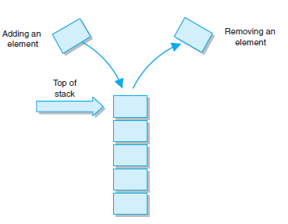
Stack ADT
Linear collection whose elements are added and removed from the same end
Processed in a last in, first out (LIFO) manner

Slide 297
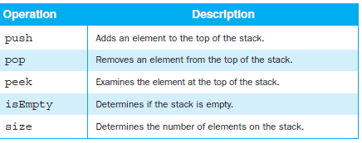
Stack Operations

Slide 298
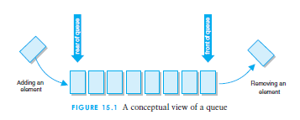
Queue ADT
Similar to its Collection side, it is FIFO
Come into 2 types:
Singly-Linked List Queue
Uses LinkedList of the List
interface
Double-Linked List Queue
Used Dequeue and LinkedList
API class

Slide 299
Collection Polymorphism
In API development, one can customize their own collections using the following interfaces:
AbstractCollection
AbstractList
AbstractSet
AbstractMap
AbstractQueue

Slide 300
Sorting List Collections
Three ways:
Normal Collections.sort() and Collections.reverse()
Using Comparable
Using Comparator

Slide 301
Comparable
A comparable object is capable of comparing itself with another object
The class itself must implements the java.lang.Comparable interface in order to be able to compare its instances

Slide 302
Rules on Comparable
Needs to override compareTo(Object obj) method:
How this method works:
This method compares this object with obj object. Returned int value has the following meanings:
positive – this object is greater than obj
zero – this object equals to obj
negative – this object is less than obj

Slide 303
Comparator
A comparator object is capable of comparing two different objects
The class is not comparing its instances, but some other class’s instances
This comparator class must implement the java.util.Comparator interface

Slide 304
Comparator Rules
The method to override is compare(Object obj1, Object obj2)
This method compares obj1 and obj2 objects. Returned int value has the following meanings:
positive – o1 is greater than o2
zero – o1 equals to o2
negative – o1 is less than o2

Slide 305
Collection Traversal
Old and New Techniques

Slide 306
Loops
Advantage: Using loops to iterate a collections is the easiest way to do
Sample:
List linkedList = new LinkedList();
Object objArr[] = linkedList.toArray();
for (Object obj : objArr){
System.out.println(obj);
}

Slide 307
Loops…
Disadvantage: For loops are expensive to the processor when the collection reaches large sizes, as many operations are done just to compute the lines
Sample:
Conversion to array = more than n times
Lookup traversal = n times
Total: 2n times

Slide 308
Iterator, ListIterator, and Enumerator
Better than the loops
Efficient when it comes to processing time
No conversion to array of Objects
Linear traversal: n times
Total: n times

Slide 309
Enumeration
An object that generates elements one at a time, used for passing through a collection, usually of unknown size
The traversing of elements can only be done once per creation
Can use 2 major methods:
nextElement(): which returns the next object in the collection
hasMoreElements(): which returns true, until the last object has been returned by nextElement()

Slide 310
Iterator
It can be used with arrays and various classes in the Collection Framework
Since Enumeration cannot modify the collection traversed, thus the Iterators are used
Can use 3 major methods:
hasNext(): returns true if there is another element in the collection
next(): hich returns the next object
remove(): which removes the last object taken using next()

Slide 311
ListIterator
An alternative to the Iterator interface and uses the same common methods
Additional properties:
Traversal of the list in either direction
Modification of its elements
Access to the element's position

Slide 312
ListIterator…
Here its methods:
next: This method returns the next element
previous: This method returns the previous element
hasNext: This method returns true if there are additional elements that follow the current one
hasPrevious: This method returns true if there are additional elements that precede the current one
nextIndex: This method returns the index of the next element to be returned by the next method

Slide 313
ListIterator…
previousIndex: This method returns the index of the previous element to be returned by the previous method
add: This method inserts an element into the list (optional)
remove: This method removes the element from the list (optional)
set: This method replaces an element in the list (optional)

Slide 314
Generics
Collections at its Specific

Slide 315

Generics
Generics allows you to abstract over types
Generics means more type-safety
The purpose of generics is to write a type-safe collections

Slide 316



Instantiation with Generics
Declaring and assigning variables of generic types
Creating instances of generified classes
Declaring and invoking methods that take generic types

Slide 317

Generic Classes
By convention, use the key “E” which means any possible Element object
“E” is the placeholder of the real type you want to use

Slide 318
Generic Classes…
We can create Generic classes through Generic Declaration
Sample:
public class Hi<E>{ … }
interface GetDataMethods<T> { … }
We can create our own API through Generics

Slide 319
Generic Methods
A generic method means that a method declaration uses a parameter type as its signature
Sample:
public <T> T getName(T data){
if (T instanceOf String){
return T + “ :String data”;
}else if (T instance of Integer){
return T;
} else{ …. }
return T;
}

Slide 320
Generic Local Parameters
We can restrict the parameter passing through generics:
Sample:
public void getName(List<String> name){…}
public void getFirstName(List<Employee> fName){…}
We can use wildcards like ?
Sample:
public getData(List<? extends Stats> statData){…}
Public getData(List<? super Stats> statData){…}

Slide 321
Generics and Inheritance
You can create a collection that contains all the subclasses of a certain superclass:
In passing generified objects, a collection argument data can be legally passed to a local parameter given that local parameter is a collection of the same type or of its subclasses
In implementing your own Collection API classes, always you apply Generics

Slide 322
The Object
Art of Instantiation

Slide 323
Object
The root of the class hierarchy
Every class has Object as a superclass
All objects, including arrays, implement the methods of this class
Methods:
clone() – create the new object of the same class
equals() – compares 2 objects for equality
finalize() – for garbage collection
getClass() – returns the runtime class of an object

Slide 324
Object…
hashCode() – returns the hashCode value of an object
notify() – wakes up a single thread
notifyAll() – wakes up all threads
toString() – returns a String representation of an Object
wait(), wait(long), wait(long, int) – waits to be notified by another thread

Slide 325
Object Anatomy
All objects live on the garbage-collectible heap including its instance variables
Local variables and method parameters live on the stack
Methods live on the stack too
In the case of references objects that are local, only the local variables referencing to the object live on the stack (e.g. inner class)

Slide 326

Object Creation
We all know that we create an object using new keyword or extends for super classes
Object creation does not mean we are calling the class rather we are calling its constructor
A constructor has the code that runs when we instantiate an object

Slide 327
Class Constructor
Each class has a constructor explicitly declared (by default)
Constructor has the same name with the class
Constructor does not give any return type
The best place to initialize
Constructor can be overloaded

Slide 328
Constructor
Depending on the purpose or design pattern, constructor can be:
private
default
Public
Private constructors are used for quantifying the number of objects

Slide 329
Constructor Keywords
this – pertains to the object itself
used if there are identifiers or methods with same name but different levels
super – pertains to the super class object
used if there are identifiers or methods with same name with the super class

Slide 330

Super Class Constructor
We all know that all constructors in an object inheritance tree must run when you make an object (chain-reaction)
We can explicitly run the superclass constructor through the
use of super() without
an argument

Slide 331
Super Class…
By default, if a superclass has overloaded constructors, only the superclass that has no-args will be called by the compiler
The call to super() must be the first statement in the constructor

Slide 332
Overloaded Constructors
Constructors just like any methods, can be overloaded
To invoke overloaded constructor to another, use this() method
The method this() is only used by a constructor within a class

Slide 333
Code Scoping
Class Layout{ // class
static int s = 343; // static variable
int x; // instance variable
{ x = 7; int x2 = 5; } // initialization block
Layout(){ x += 8; int x3 = 6; } // constructor
void doStuffs(){ // method
int y = 0; // local variable
for(int z = 0; z < 4; z++){ // code block (for-loop)
y += z + x; // z is a block variable
}
}
}

Slide 334
Initialization Blocks
Third place where operations can be performed. The were methods and constructors that was discussed in the previous slides.
Types:
Runs where the class is first loaded (static)
Runs when an instance is first created (instance)
JVM returns ExceptionInInitializationError once syntax error is encountered.

Slide 335
Enum Classes
Constant Objects

Slide 336
Problems with Class/Static variables
Class variables are static and mostly used to represent a global value like e, PI, etc…
Problems once these variables are used as representation:
Non-typesafe – these are int and whenever someone adds value to it as long as valid, representation will not hold true

Slide 337
Representation
No namespace – usually they just follow business convention like using prefix tag_, item_, DISCOUNT_, etc
Brittle – the set of tags might be true only for a particular snapshot; there are times these are changed because they are just individual data
Printed values are non-informative – the data are just mere values they do not have supporting descriptions and characteristics

Slide 338
Solution
Java Enum classes
Note: Not the enum in PHP/VB/C ☹

Slide 339
Enum classes
Creating an Enum is creating a new class implicitly extending java.lang.Enum
Enum is declared as a standalone class in its own source file or as a member of another class
All item in enum are static and final objects are which enum instances

Slide 340
Characteristics
Enum in Java are reference type
Enums in Java are type-safe
You can specify values of enum constants at the creation time
Enum constants are implicitly static and final and can not be changed once created
Can be used with switch statements (atomic)
Since constants defined inside Enum in Java are final you can safely compare them using "=="
Java compiler automatically generates static values() method for every enum in java

Slide 341
Characteristics…
In Enum, not all methods can be overriden.
All instance variables of enum has instant setter/getter
Has own collections: EnumMap and EnumSet Cannot create Enum using new operator
Instance of Enum in Java is created when any Enum constants are first called or referenced in code
Can implement interface and override methods just like a normal class
Can implement abstract methods inside Enum

Slide 342
Declaration and Instantiation
Since an enum is static and final, the whole package must have unique enum names
Sample:
enum Cards {SPADE, CLOVER, HEARTS, DIAMONDS}
Cards ChooseCard = Cards.CLOVER;
We do not use new keyword
We cannot declare enum inside any methods

Slide 343
Enum methods
These are some popular methods inside an Enumeration:
values() – get all the values used in for loops
compareTo(…), equals(…) – compare an enum element to another enum element
ordinal() – get the sequence value of the enum element
name() – get the name of the enum element

Slide 344
Customizing Enum classes
All the methods of enum can be accessed inside the enum class
An enum class is just a class so we can add custom methods to it
If you need to customize your enumeration classes, the sequence of the enum instances must be ended up with a semicolon
Constructor must be private and must have local parameter corresponding to the values in each enum instances

Slide 345
Enum Structures
Inheritance is not allowed in enumeration classes; polymorphism is allowed
Uses interfaces to organize hierarchy of enumeration

Slide 346
Data Structures
EnumSet – to keep track of enum values
Set sample<Color> enumSet = EnumSet.noneOf(Color.class);
EnumMap – serves as a Map where the key must be an element of the enum
Map sample<Color, String> enumMap = new EnumMap<Color, String>(Color.class)

Slide 347
Garbage Collections
Housekeeping JVM

Slide 348
When to GC?
Last task to be done after development or deployment
The concept of “stop-the-world” occurs when calling GC (e.g. System.gc())
All threads halt except for the threads needed by GC! ☺
GC will drastically change the environment leading to some unwanted expectations

Slide 349
When to GC?
Do GC only if you have NOT done the following:
The memory size has been specified using -Xms and –Xmx options
The -server option is included
Logs such as Timeout log are not left in the system

Slide 350
Garbage Collection
The problem always encountered in JVM is the memory leak problem
Infinite loops
Declaring class names that are API classes
Using static collections:
public class Leaker {
private static final Map<String, Object> CACHE = new HashMap<String, Object>();
// Keep adding until failure.
public static void addToCache(String key, Object
value){
Leaker.CACHE.put(key, value);
}
}

Slide 351
Garbage Collections…
Abusing Strings:
public class StringLeaker {
private String muchSmallerString;
public StringLeaker() {
// Imagine the whole Declaration of Independence here
String veryLongString = "We hold these truths to be self-evident...";
// The substring here maintains a reference to the internal //char[]
// representation of the original string.
this.muchSmallerString = veryLongString.substring(0, 1);
}
}

Slide 352
Memory Leak (OutOfMemoryError)
JVM will throw java.lang.OutOfMemoryError
When to make your objects eligible for GC:
All references of that object explicitly set to null
Object is created inside a block and reference goes out scope once control exit that block
Parent object set to null, if an object holds reference of another object and when you set container object's reference null, child or contained object automatically becomes eligible for garbage collection
If an object has only live references via WeakHashMap it will be eligible for garbage collection. To learn more about HashMap see here How HashMap works in Java

Slide 353
Other Solutions
Implement Finalization:
create finalizer in each class();
Run runFinalization() and runFinalizationOnExit() at the end of the day
Using Runtime or System GC but not always effective
Overriding finalize() method for each object that will undergo GC but do not abuse
Is being called once the runFinalization() or any finalizers are called

Slide 354

Setting JVM Options

Slide 355
OutOfMemoryError
You can set the Perm area size with the -XX:PermSize and -XX:MaxPermSize options but only when OutOfMemoryError occurs and the cause is the Perm area size

Slide 356
GC Types (Java 1.7)
Serial GC
Parallel GC
Parallel Old GC (Parallel Compacting GC)
Concurrent Mark & Sweep GC (or "CMS")
Garbage First (G1) GC

Slide 357
Serial GC (-XX:+UseSerialGC)
The GC in the young generation uses the type we explained in the previous paragraph. The GC in the old generation uses an algorithm called "mark-sweep-compact."
The first step of this algorithm is to mark the surviving objects in the old generation.
Then, it checks the heap from the front and leaves only the surviving ones behind (sweep).
In the last step, it fills up the heap from the front with the objects so that the objects are piled up consecutively, and divides the heap into two parts: one with objects and one without objects (compact).
The serial GC is suitable for a small memory and a small number of CPU cores.

Slide 358

Parallel GC (-XX:+UseParallelGC)

Slide 359
From the picture, you can easily see the difference between the serial GC and parallel GC.
While the serial GC uses only one thread to process a GC, the parallel GC uses several threads to process a GC, and therefore, faster. This GC is useful when there is enough memory and a large number of cores. It is also called the "throughput GC."

Slide 360
Parallel Old GC(-XX:+UseParallelOldGC)
Parallel Old GC was supported since JDK 5 update. Compared to the parallel GC, the only difference is the GC algorithm for the old generation. It goes through three steps: mark – summary – compaction.
The summary step identifies the surviving objects separately for the areas that the GC have previously performed, and thus different from the sweep step of the mark-sweep-compact algorithm. It goes through a little more complicated steps.

Slide 361

CMS GC (-XX:+UseConcMarkSweepGC)

Slide 362
CMS
Concurrent Mark-Sweep GC is much more complicated than any other GC types
The early initial mark step is simple. The surviving objects among the objects the closest to the classloader are searched. So, the pausing time is very short.
In the concurrent mark step, the objects referenced by the surviving objects that have just been confirmed are tracked and checked. The difference of this step is that it proceeds while other threads are processed at the same time.
In the remark step, the objects that were newly added or stopped being referenced in the concurrent mark step are checked.
Lastly, in the concurrent sweep step, the garbage collection procedure takes place.
The garbage collection is carried out while other threads are still being processed. Since this GC type is performed in this manner, the pausing time for GC is very short. The CMS GC is also called the low latency GC, and is used when the response time from all applications is crucial.

Slide 363
CMS…
Disadvantages:
It uses more memory and CPU than other GC types.
The compaction step is not provided by default.

Slide 364
G1 GC
If you want to understand G1 GC, forget everything you know about the young generation and the old generation.
As you can see in the picture, one object is allocated to each grid, and then a GC is executed.
Then, once one area is full, the objects are allocated to another area, and then a GC is executed.
The steps where the data moves from the three spaces of the young generation to the old generation cannot be found in this GC type. This type was created to replace the CMS GC, which has causes a lot of issues and complaints in the long term.
The biggest advantage of the G1 GC is its performance. It is faster than any other GC types that we have discussed so far

Slide 365

G1 GC

Slide 366
Implementing Collectors
Throughput garbage collector
Running java command with-XX:+UseParallelGC option
Concurrent low pause collector
Running java with command -Xingc or -XX:+UseConcMarkSweepGC
Incremental low pause collector
Running java command with -XX:+UseTrainGC

Slide 367

GC Type Options

Slide 368
Nested Classes
Design-oriented Classes

Slide 369
Nested Classes
Classes that are defined inside another class called the nested class
Objective:
To clearly group the nested class with its surrounding class, signaling that these two classes are to be used together
Nested classes are considered members of their enclosing class.
Nested class can be declared:
public, default, protected and private
Sometimes called inner or member classes

Slide 370

Properties
An inner class can use all the methods and variables of the outer class even the private members

Slide 371

Properties…
All properties and methods of the outer class is accessible to the nested classes

Slide 372



Nested Objects Reference
An inner object must be tied to a specific outer object on the heap.
An arbitrary instance of an inner class cannot access all the methods and variables of the outer class

Slide 373
Instantiating Nested Classes
You can instantiate nested classes in two ways:
within the outer class
outside the outer class

Slide 374
Types of Nested Classes
Non-static or inner classes
Static inner classes
Local inner classes
Anonymous inner classes

Slide 375
Non-static or inner classes
Non-static nested classes are also called inner classes
Inner classes are associated with an instance of the enclosing class. Thus, you must first create an instance of the enclosing class to create an instance of an inner class.

Slide 376
Shadowing
If an inner class declares fields or methods with the same names as field or methods in its enclosing class, the inner fields or methods are said to shadow over the outer fields or methods.

Slide 377
Static Nested Classes
A static nested class is essentially a normal class that has just been nested inside another class
It interacts with its enclosing class in the same way.
Being static, a static nested class can only access instance variables of the enclosing class via a reference to an instance of the enclosing class

Slide 378
Local Inner Classes
Sometimes called Method-local inner classes
Local classes are like inner (non-static nested) classes that are defined inside a method or scope block ({ ... }) inside a method
Local classes can only be accessed from inside the method or scope block in which they are defined.
Local classes can access members (fields and methods) of its enclosing class just like regular inner classes.
Local classes can also access local variables inside the same method or scope block, provided these variables are declared final.

Slide 379
Local Inner Classes…
Local classes can also be declared inside static methods. In that case the local class only has access to the static parts of the enclosing class.
Local classes cannot contain all kinds of static declarations (constants are allowed - variables declared static final), because they are non-static in nature - even if declared inside a static method.

Slide 380
Anonymous Inner Classes
Anonymous classes are classed without a class name. They are typically declared as either subclasses of an existing class, or as implementations of some interface.
Anonymous classes are defined when they are instantiated.
Anonymous classes can also implement an interface instead of extending a class

Slide 381
Anonymous Inner Classes…
An anonymous class can access members of the enclosing class. It can also access local variables which are declared final or effectively final.
You can declare fields and methods inside an anonymous class, but you cannot declare a constructor. You can declare a static initializer instead, though.

Slide 382
Input/Output Transactions

Slide 383
I/O Transactions
File Management
RandomAccessFile
Stream Management
Serialization Process
Android and Large Media

Slide 384
File Transactions
File management is the manner in which files are monitored and controlled for standard I/O access
The File class provides a constructor to create a file handle
This File handle is then used by various File class methods to access the properties of a specific file or by File stream constructors to open files

Slide 385
File Creation
Can create physical files
File simple=new File("sample.dat");
File y = new File("subfolder/sample.dat");
File soft=new File(args[0]);
Can create folder structures
mkdir() method

Slide 386
File Object
Objects of type File are used to represent the actual files (but not the data in the files) or directories that exist on a computer's physical disk
Initializing a File object (No File Yet)
import java.io.*;
class Writer1 {
public static void main(String [] args) {
File file = new File("fileWrite1.txt");}
}

Slide 387
import java.io.*;
class Writer1 {
public static void main(String [] args) {
try {
boolean newFile = false;
File file = new File
System.out.println(file.exists());
newFile = file.createNewFile();
System.out.println(newFile);
System.out.println(file.exists());
} catch(IOException e) { }
}
}

Slide 388
File methods
Accessors:
getAbsolutePath(), getCanonicalPath(), getName(), getPath(), getParent(), lastModified(), length(), list() {returns array of String}, listFiles() {returns array of File objects}.
Mutators:
delete(), deleteOnExit(), mkdir(), mkdirs(), renameTo(), setLastModified(), setReadOnly().
Boolean methods:
canRead(), canWrite(), compareTo(), exists(), isAbsolute(), isDirectory(), isFile(), isHidden().

Slide 389
File Streams
File streams are primitive streams whose sources or destinations are files
Overwrites the files
Always throws exception

Slide 390
File Stream By Bytes
Read/Write byte at a time:
FileInputStream
FileOutputStream
Read/Write character at a time
FileReader
FileWriter

Slide 391
File Stream by Character
FileWriter
Opens the file for writing
Creates a an actual file
Flushed last data input
Closes file for reading
FileReader
Opens the file for reading
Read bytes from file

Slide 392
File Stream by String
PrintWriter
BufferedReader

Slide 393
Data Stream I/O
Data Streams are streams whose sources and destinations are other streams (not files)
They are known as wrappers because they wrap the primitive file stream object mechanism inside a more powerful one.
Stream objects
System.in – read data from the keyboard
System.out – outputs to the computer screen

Slide 394
Data Streams
Data streams are buffered so that more than a single 8/16 bit quantity is processed at a time.
The basic buffered streams:
BufferedInputStream()
BufferedOutputStream()
DataInputStream()
DataOutputStream()
InputStreamReader()
OutputStreamReader()
BufferedReader()
BufferedWriter()

Slide 395
Binary Files
Binary Files
DataInputStream()
writeUTF()
DataOutputStream()
readUTF()

Slide 396
Randomized Access
RandomAccessFile
Treats the file as an array of Bytes
And you can write your data in any position of the Array.
To do that, it uses a pointer that holds the current position
Methods:
getFilePointer() to get the current position of the pointer
seek(int )to set the position of the pointer
read(byte[] b) to reads up to b.length bytes of data from the file into an array of bytes
write(byte[] b) to write b.length bytes from the specified byte array to the file, starting at the current file pointer

Slide 397
Serialization
Process that persists java objects in a form of ordered or sequence of bytes that includes the object’s data as well as information about the object’s type and the types of data stored in the object.
Note: So if we have serialize any object then it can be read and de-serialize it using object’s type and other information so we can retrieve original object
Uses
ObjectInputStream
writeObject()
ObjectOutputStream
readObject()

Slide 398
Non-Stream
Using NIO 1.0 and 2.0
Buffered based
Uses Channel instead of Streams
Purpose
large media storage
frequent I/O like mobile apps

Slide 399
Buffer
A Buffer is an object, which holds some data, that is to be written to or that has just been read from
Types:
ByteBuffer
CharBuffer
ShortBuffer
IntBuffer
LongBuffer
FloatBuffer
DoubleBuffer

Slide 400
Chanel
A Channel is an object from which you can read data and to which you can write data
Types:
Any InputStream or OutputStream family

Slide 401
Threading
Introduction to Concurrency

Slide 402
Threading
Multithreading refers to two or more tasks executing concurrently within a single program
A thread is an independent path of execution within a program
Many threads can run concurrently within an execution
Every thread in Java is created and controlled by at least the java.lang.Thread class

Slide 403

Inter-object communication

Slide 404
Creating Threads
Extend java.lang.Thread class if you want to create several different types of threads
Implement Runnable interface if you want to create a process that can be executed by different threads

Slide 405
The Runnable version
Make a Runnable object (the thread’s job)
Make a Thread object (the worker) and give it a Runnable (its job)
Start the thread

Slide 406

Runnable version…
Implicitly declared because it is found in java.lang package
Implements the job for the threads
It has only one method to implement:
public void run()

Slide 407
Thread class
Aside from extending Thread class, we can implement this to represent the worker of the job

Slide 408
Thread processes
NEW state – once created
RUNNABLE state – once started
RUNNING state – thread has executed running on top of the stack
BLOCKED state
Waiting for a data input
Waiting for a call to locked methods
Put into sleep()

Slide 409
Starting a Thread
When start() method is invoked:
A new thread of execution starts (with a new call stack).
The thread moves from the new state to the running state.
When the thread gets a chance to execute, its target run() method will run.

Slide 410
Accessing current Thread Information
Thread.currentThread()
Thread .currentThread().getName()
By default each thread has a name “Thread-0” for first thread, “Thread-1” for second thread, etc.

Slide 411
Blocked State (from Runnable)
A thread becomes Not Runnable when one of the following four events occurs:
When sleep() method is invoked and it sleeps for a specified amount of time
When suspend() method is invoked
When the wait() method is invoked and the thread waits for notification of a free resource or waits for the completion of another thread or waits to acquire a lock of an object.
The thread is blocking on I/O and waits for its completion

Slide 412
From Blocked to Runnable
A process at halt can be awaken by the ff:
a thread has been put to sleep, then the specified number of milliseconds must elapse (or it must be interrupted)
If a thread has been suspended, then its resume() method must be invoked
If a thread is waiting on a condition variable, whatever object owns the variable must relinquish it by calling either notify() or notifyAll()
If a thread is blocked on I/O, then the I/O must complete.

Slide 413
Dead State
A thread enters this state when the run() method has finished executing or when the stop() method is invoked.
Once in this state, the thread cannot ever run again

Slide 414
Thread Implementation
Multi-threading is the process by which more than one threads are running
Thread run asynchronously be default
You don’t which one started first or finished last only JVM knows

Slide 415
Synchronization
Synchronization is a process of controlling the access of shared resources by the multiple threads in such a manner that only one thread can access a particular resource at a time
There can be 2 ways through which synchronized can be implemented in Java:
synchronized methods
synchronized blocks

Slide 416
Methods for Synchronization
sleep(…)
yield()
Manages threads of similar priorities to move back to runnable
setPriority(…)
Gives priority to the thread usually 1 – 10 but not 100 guaranteed correct
Uses constants Thread.MIN_PRIORITY, etc
join()
Guarantees the current thread to stop executing until the thread it joins with completes

